Slide 2
WE WILL DISCUSS HERE :
Introduction to “Medical Emergencies in EMS“.
The Idea that motivates me to implement the grant project.
Strategy that has been used in project implementation.
Importance of “Medical Emergencies in EMS”.
Some results and statistics gathered from students.
Project output in the form of screenshots.
Recommendation and Project future extension.

Slide 3
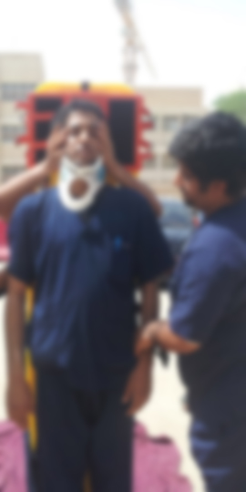
Introduction to
Medical Emergencies in EMS
● Most of this course is interactive lectured based taught using PowerPoint and LMS and during Labs the student are given the scenario to deal with the manikins as a patient to take care of them.
● Both theoretical and practical skills are important aspects of a proper medical training.
● Using multimedia based interactive computer simulation is much easier to assess a student's progress.

Slide 4
Introduction to
Medical Emergencies in EMS
● Medical Emergencies in EMS is an animated interactive program package that helps paramedic students in getting better understanding of their course contents along with the interactive practical knowledge.
● The whole program is divided into two parts- EMS Practical Kit and Academic Lessons, The EMS Practical kit is having various cases designed by experienced EMTs and these cases are linked together to the second part of the program that is nothing but the Academic Lessons.

Slide 6
The Idea that Motivates me
● Developing innovative and interactive method of teaching strategy with productive impact on students learning.
● Improving students’ attention and retention to training content by making the training process engaging.
● To engage students and improve learning outcomes.
● Allowing students to go through the computer simulation programs before trying their hands on patients’ precious life and costly manikins.
● Use valuable in-class time for concept application; learn core content via multimedia.

Slide 8
Strategy, Used in Project Implementation
● Iterative waterfall model has been used throughout the grant project “Medical Emergencies in EMS” development life cycle.
● We used Iterative Waterfall Model because it is considered to be the best model for an application whose requirements are well understood and hence we followed this model because of the fact that we were spending enough time in requirement analysis of the grant project.
● The Iterative Waterfall Model is progressed through five key phases.
Requirement and Analysis, Design, Implementation, Testing, Deployment and Evaluation.

Slide 9
Strategy, Used in Project Implementation
● Requirement and Analysis: All possible requirements of the system are captured in this phase and documented in a requirement specification doc.
● Design: The requirement specifications from first phase are studied in this phase and system design is prepared. System Design helps in specifying hardware and system requirements and also helps in defining overall system architecture.
● Implementation: With inputs from system design, the system is first developed in small programs called units, which are integrated in the next phase. Each unit is developed and tested for its functionality which is referred to as Unit Testing.
● Testing: All the units developed in the implementation phase are integrated into a system after testing of each unit. Post integration the entire system is tested for any faults and failures.
● Deployment and Evaluation: Once the functional and non-functional testing is done, the product is deployed in the customer environment or released into the market.

Slide 10
Strategy, Used in Project Implementation
Phases | Month 01/06 | Month 02/06 | Month 03/06 | Month 04/06 | Month 05/06 | Month 06/06
Requirement & Analysis
Design
Implementation
Testing
Deployment and Evaluation

Slide 11
Importance of
Medical Emergencies in EMS
● The grant project “Medical Emergencies in EMS” is designed in such a way to give the student a better understanding of emergency medical services by means of computer simulation.
● It is going to develop an innovative and interactive method of teaching strategy with productive impact on students learning.
● It is improving students’ attention and retention to training content by making the training process engaging.
● It is allowing students to go through the computer simulation programs before trying their hands on patients’ precious life and costly manikins.

Slide 12
Importance of
Medical Emergencies in EMS
● It is providing a generic interactive user-friendly multimedia framework where the learners and practitioners both feel easy.
● The course contents has been designed in such a way so that a vast group of EMS students are getting benefitted from it.
● All the interactive and multimedia scenarios have been developed by keeping expensive manikins in the center so that it could be avoided to any potential damage during the procedures.

Slide 13
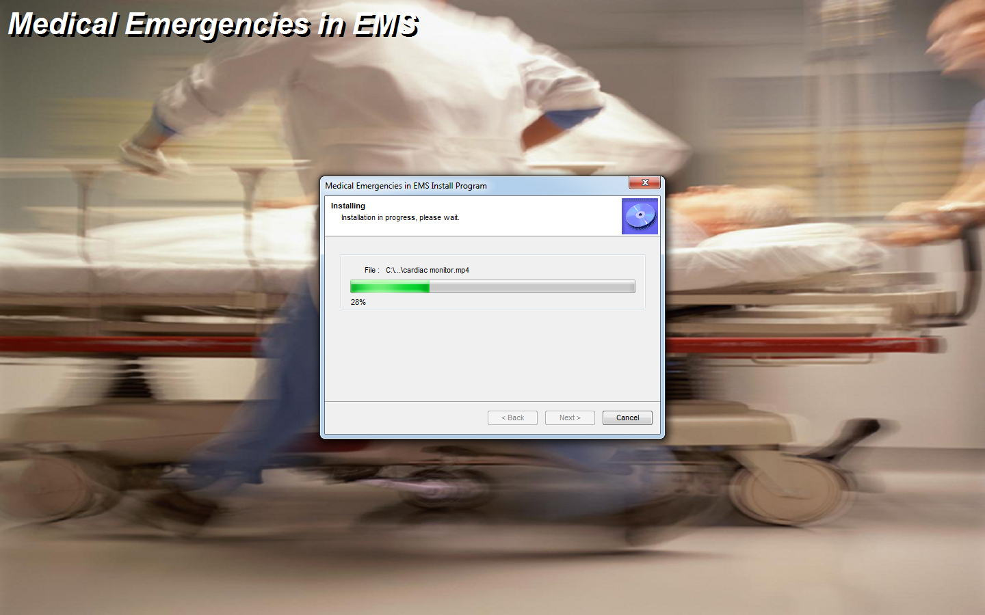
Project Screenshots
The Grant Project Installation Screen

Slide 14
Project Screenshots
A screenshot from Medical Emergencies in EMS

Slide 15
Project Screenshots
A screenshot from Medical Emergencies in EMS

Slide 16
Project Screenshots
A screenshot from Medical Emergencies in EMS

Slide 17
Project Screenshots
A screenshot from Medical Emergencies in EMS

Slide 18
Project Screenshots
A screenshot from Medical Emergencies in EMS

Slide 19
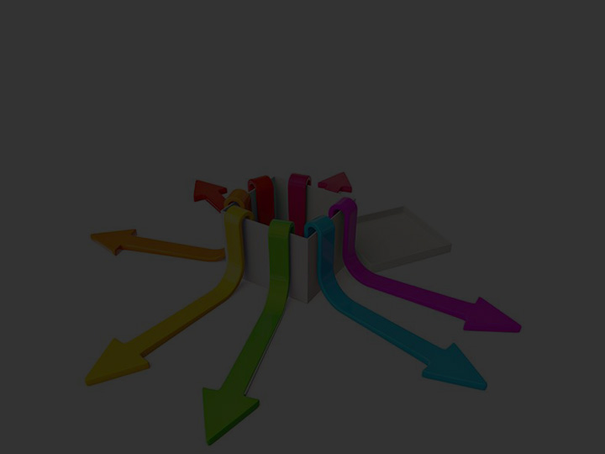
Recommendation and Future Extension
● We can put a practice session after each and every Emergency Medical Services procedure so that students could know himself how much he has been able to understand the procedure and he could rate himself on a learning scale.
● After each and every procedure we can also have a multiple choice answer type quizzes.
● We can extend the program for various mobile platforms such as Android, iPhone, Windows Phones etc and in the same way we can extend it for the pads too.

Slide 20
Thank You! CELT
for turning my Idea into a successful product

